Slide 1


Are women safe in India
“Women's safety is not a privilege; it's a basic human right."
Done by : Madhumitha B
Women Safety

Slide 2
Agenda
Problem statement
Statistical analysis
Proposed solution
Women Safety

Slide 3

Proposed Solution
Pocket size Device
Stun Gun
Triggering gun with alert system
3
Women Safety

Slide 4
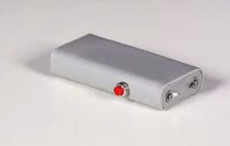
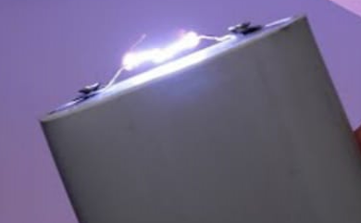
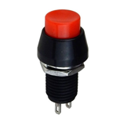
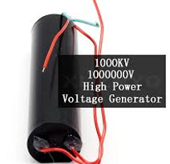
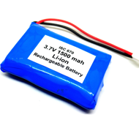

PUSH BUTTON SWITCH
HIGH VOLTAGE GENERATOR
Pocket size Device
THIS DEVICE IS USED FOR SAFETY CAN BE CARRIED IS ALL PLACES .IT IS MADE WITH THE HELP OF PVC PIPE OF SIZE 26MM THIN SO IT WILL BE EASY TO CARRY IN POCKET ALL THE TIME .IT WILL PRODUCE SPARK WHEN WE PRESS THE PUSH BUTTON SO IT MAKES THE OPPOSITE PERSON TO GET SHOCKED SO THEY WILL BE DISABLE FOR 60 SEC BZZ ITS ONLY 3.7 VOLTS
3.7 V RECHARGEABLE BATTERY
26 MM PVC PIPE
Women Safety

Slide 5
STUN GUN
CELL HOLDER
LITHIUM BATTERY
PUSH BUTTON
The Device is made up of some components like 6v-9v battery ,a booster, a cell holder and a switch and it can be reused with help of charging ,this device consist of charger
IT CAN BE CARRIED IN ALL TYPE OF BAGS
POUCH
HANDBAG
SCHOOLBAG
COLLEGE BAG
EVEN SIDE BAG
PVC PIPE
3-6V BOOST
Women Safety

Slide 6
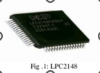
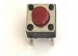
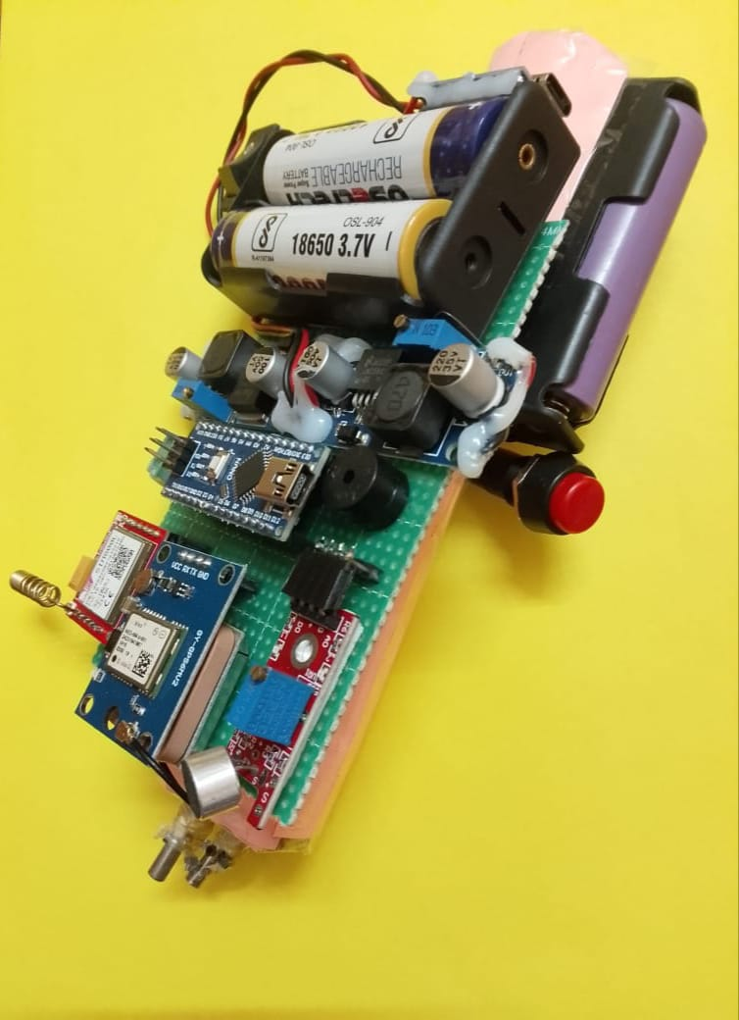
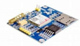
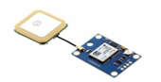
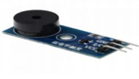
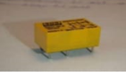
COMPONENTS USED
TRIGGER GUN WITH ALERT SYSTEM
Emergency Alert & Location Sharing Module
This module ensures real-time distress communication by sending emergency alerts
To predefined contacts.
Key Components:
GPS (NEO-6M) – Captures real-time location data.
GSM (SIM800L) – Sends emergency SMS with live coordinates.
Microcontroller (ATmega328P) – Controls and processes data.
Sound Sensor (KY-038) – Detects distress sounds (like screams) and triggers alerts automatically.
Buzzer – Produces a loud alarm to attract attention.
Working Mechanism:
Manual Activation: User presses the emergency button to trigger an alert.
Automatic Activation: The sound sensor detects loud distress noises and triggers the alert.
Location Tracking: The GPS module captures real-time coordinates.
Emergency Alert Transmission: The GSM module sends an SMS containing the user’s live location to predefined contacts.
Buzzer Activation: A loud alarm is emitted to draw attention and seek immediate help.
ARM Microcontroller
Push Button
GSM
GPS
BUZZER
RELAY
Women Safety

Slide 7
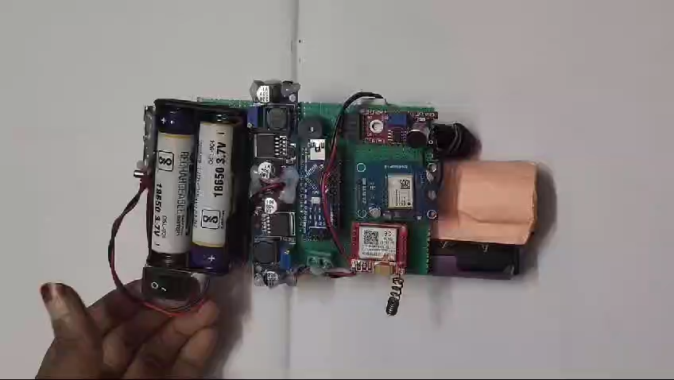
Vedio demo

Slide 8
Thank you
Women Safety

